Slide 1


Developing and Adopting Open Source and Open Standard Solutions
Dr. Charles R. Severance University of Michigan School of Information

Slide 2
Open Source Enters the LMS Market in 2004
2004年にオープンソースがLMS市場に参入

Slide 3
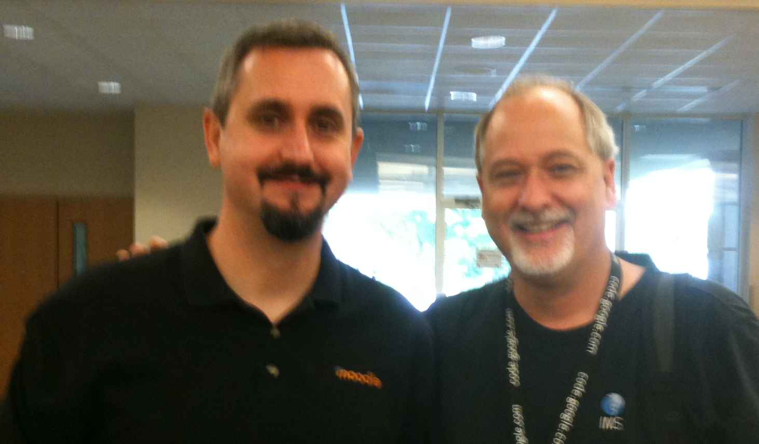


2004年に2つの始まり
2つのオープンソースLMS
Innovative Teacher
PhD Education (Internet-based Education)
Masters of Science (Science Education)
Instructional design and support
Innovative Teacher
PhD. CS, (High Performance Computing)
M.S. CS – (Real Time Database Systems)
IEEE POSIX Standards Leadership

Slide 4
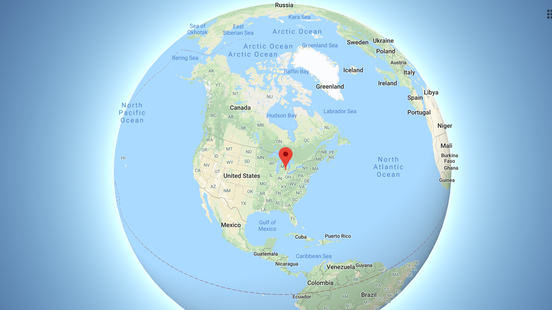

Slide 5
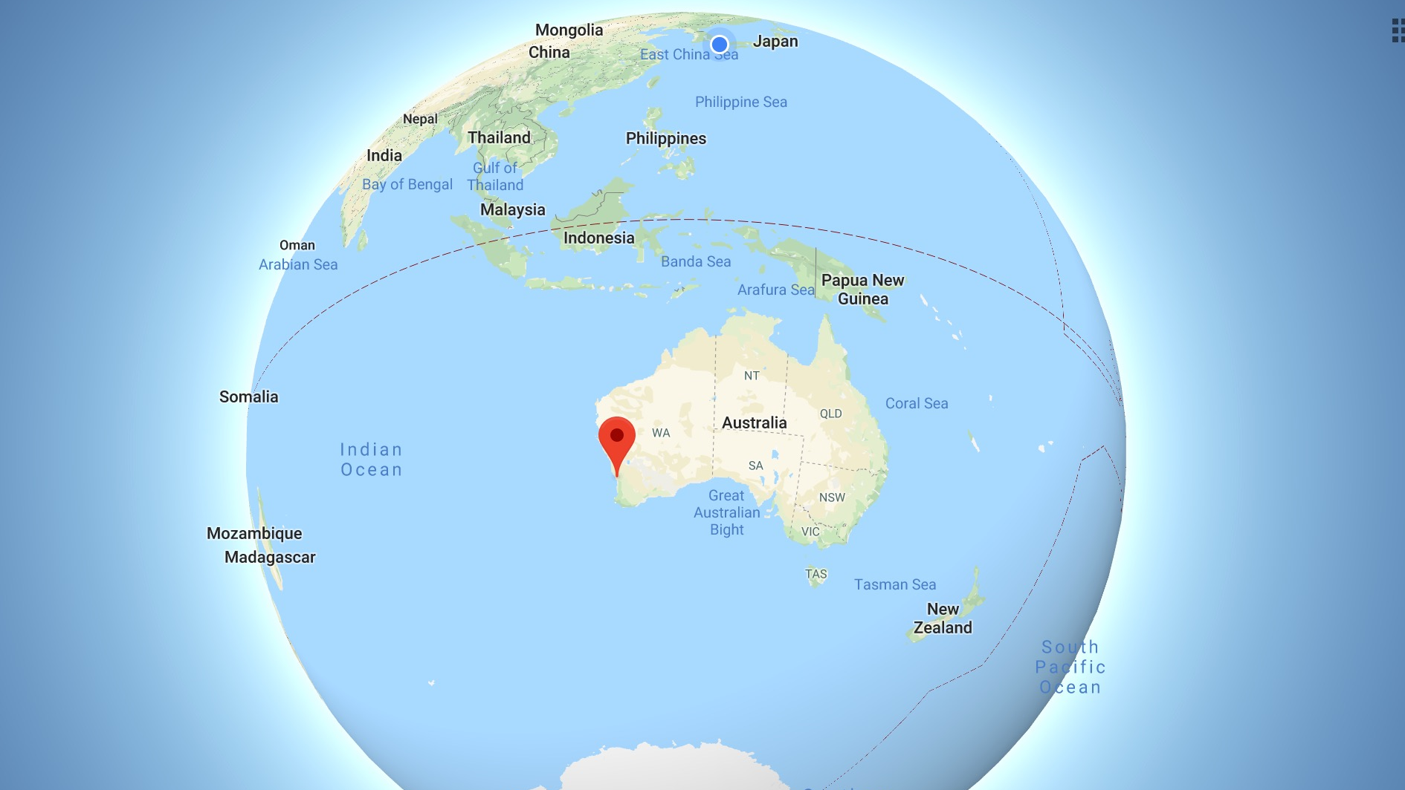

Slide 6
15年後
Results
結果
Written in PHP
Dominant market share outside North America
Lowest cost LMS
Build a massive active worldwide teacher community (MOOTs)
A million lines of Java
Small market share – leading research universities
Built standards
Founded Apereo
Teaches MOOCs

Slide 7
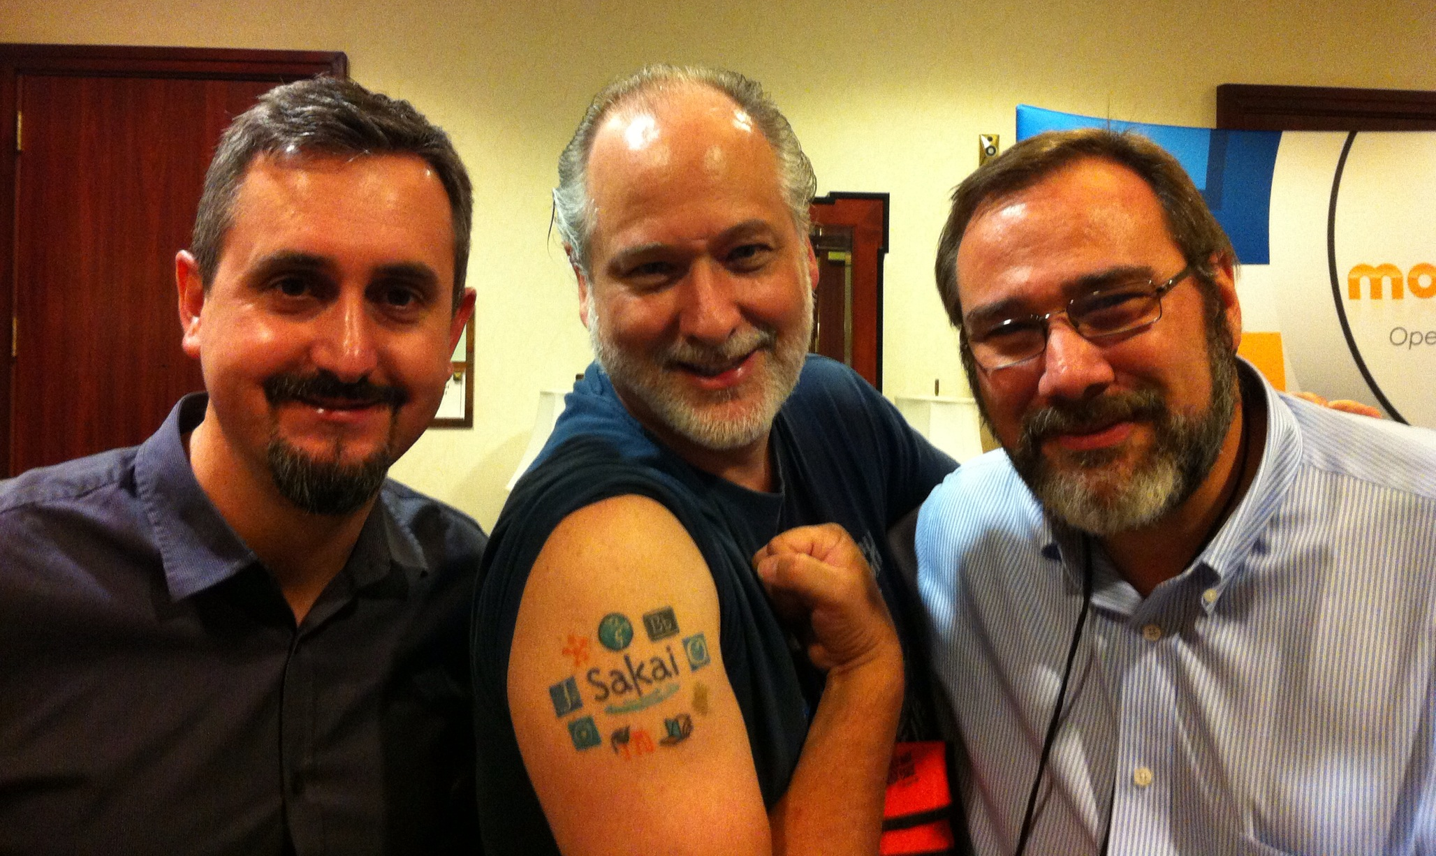

Slide 8
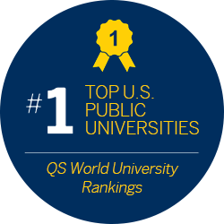


The products of this project will include an Enterprise Services-based Portal, a complete Course Management System with sophisticated assessment tools, a Research Support Collaboration System, a Workflow Engine, and a Tool Portability Profile, i.e., clear standard for writing future tools that can extend this core set of educational applications.
- A proposal to the Andrew W. Mellon Foundation, 2003-12-02
https://www.immagic.com/eLibrary/ARCHIVES/GENERAL/U_MICH/S031202P.pdf

Slide 9
Changing LMS Standards 2004-2019
LMS標準2004-2019の変更

Slide 10

2002年の高等教育LMS標準
OKI – Open Knowledge Initiative (MIT)
Schools Interoperability Framework Association (SIFA)
IMS (2002)
IEEE Learning Technology Standards Group (LTSC)
Pearson
Blackboard
D2L
WebCT
Angel

Slide 11
IMS TI 1.0 (2004)
Pearson
Blackboard
Sakai
D2L
WebCT
Angel
Moodle

Slide 12
IMS LTI 1.0 (2010)
Pearson
Blackboard
Sakai
D2L
Moodle
Canvas

Slide 13
IMS LTI 1.1 (2012)
Pearson
Blackboard
Sakai
D2L
Canvas
Moodle
の父 Learning Tools Interoperability

Slide 14
IMS LTI 2.0 (2014)
Blackboard
Vitalsource
D2L
Sakai
Canvas
Moodle

Slide 15
IMS LTI Advantage (2019)
Blackboard
Vitalsource
D2L
Turnitin
Canvas
Cengage
Moodle
Tsugi
Sakai
の祖父 LTI Advantage

Slide 16
LTI Advantage
NGDLEは今ここにあります

Slide 17
前例のない幅広さと採用
LTI 1.3
Open ID Connect
JSON Web Tokens
Deep Linking
Evolved Content Item
Names and Roles
Gradebok Service
LMS
Blackboard
Canvas
Moodle
Sakai
Desire2Learn
Tools / Publishers
TurnitIn
VitalSource
Tsugi

Slide 18

新しいユースケースが可能になりました
Multi vendor
Learning Object Repositories
Application Stores
Publisher content / integration
Challenges
It is tempting to use proprietary extensions when you have customers with just one LMS
Tool vendors don't want to re-architect applications – certify for the "new version"

Slide 19






IMS LTI Advantage® IMS Common Cartridge®

Slide 20
What is next?
次は何ですか？

Slide 21
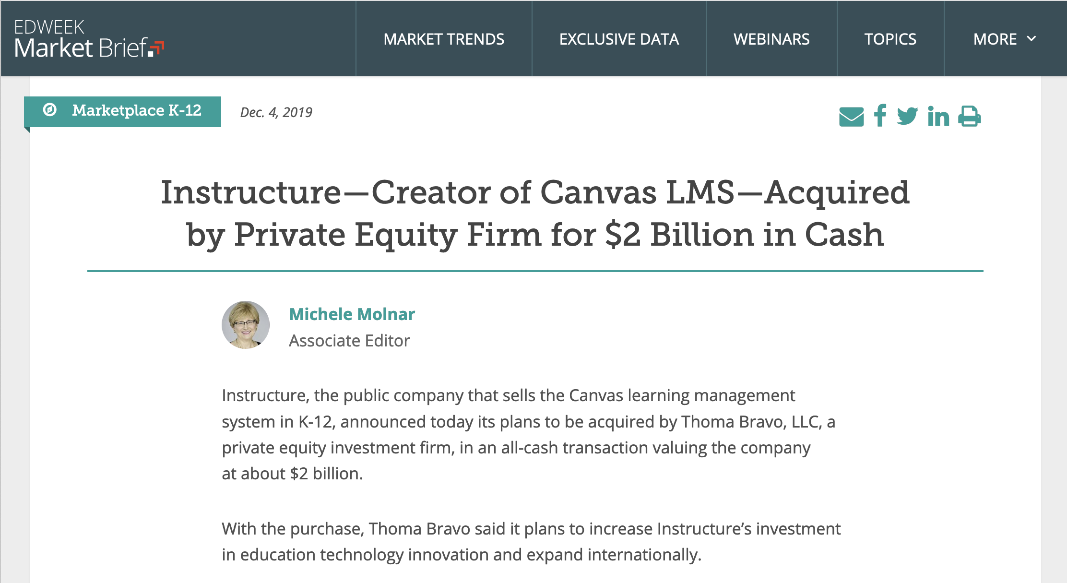

Slide 22
Open source
Serve teaching, learning and the academic mission
Range of hosting choices
Pushing forward informed by adopters and users
Proprietary
Serve shareholder value
Exclusively software as service from one vendor
Innovation slows as market share grows
Sakai and Moodle have selflessly served education for 15 years

Slide 23
Open source
Serve teaching, learning and the academic mission
Range of hosting choices
Pushing forward informed by adopters and users
Proprietary
Serve shareholder value
Exclusively software as service from one vendor
Innovation slows as market share grows

Slide 24
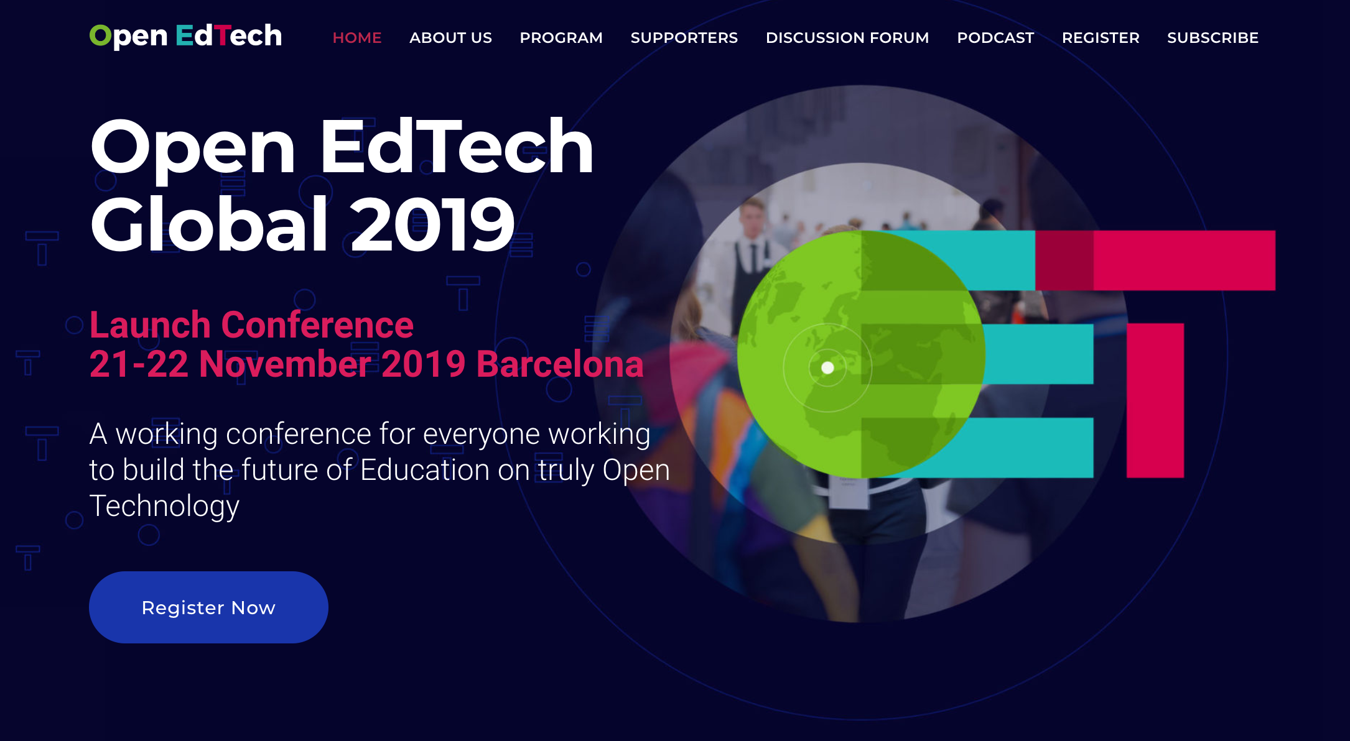

Slide 25
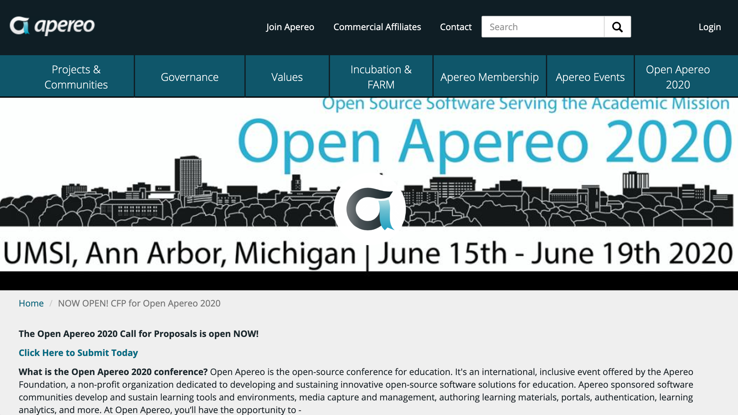
cxxcxc

Slide 28


There is little overlap between target customers
Apereo is open source research and development on hard problems
Moodle meets the needs of less research oriented schools that primarily need a product
Matching strengths and weaknesses
Friendship and respect have been there all along

Slide 30
Java
OK to modify the code
Complex hosting
Upgrade 1-2 years
Contrib tools are hard to maintain
Senior developers
PHP
Do not modify the code
Simple hosting
Upgrade 1-2 years
Modules are hard to maintain
Senior developers
PHP or Python
Adding / modifying tools is easy
Scalable multi-tenant hosting
Upgrade every night
Tools don't need to change
Junior developers

Slide 31
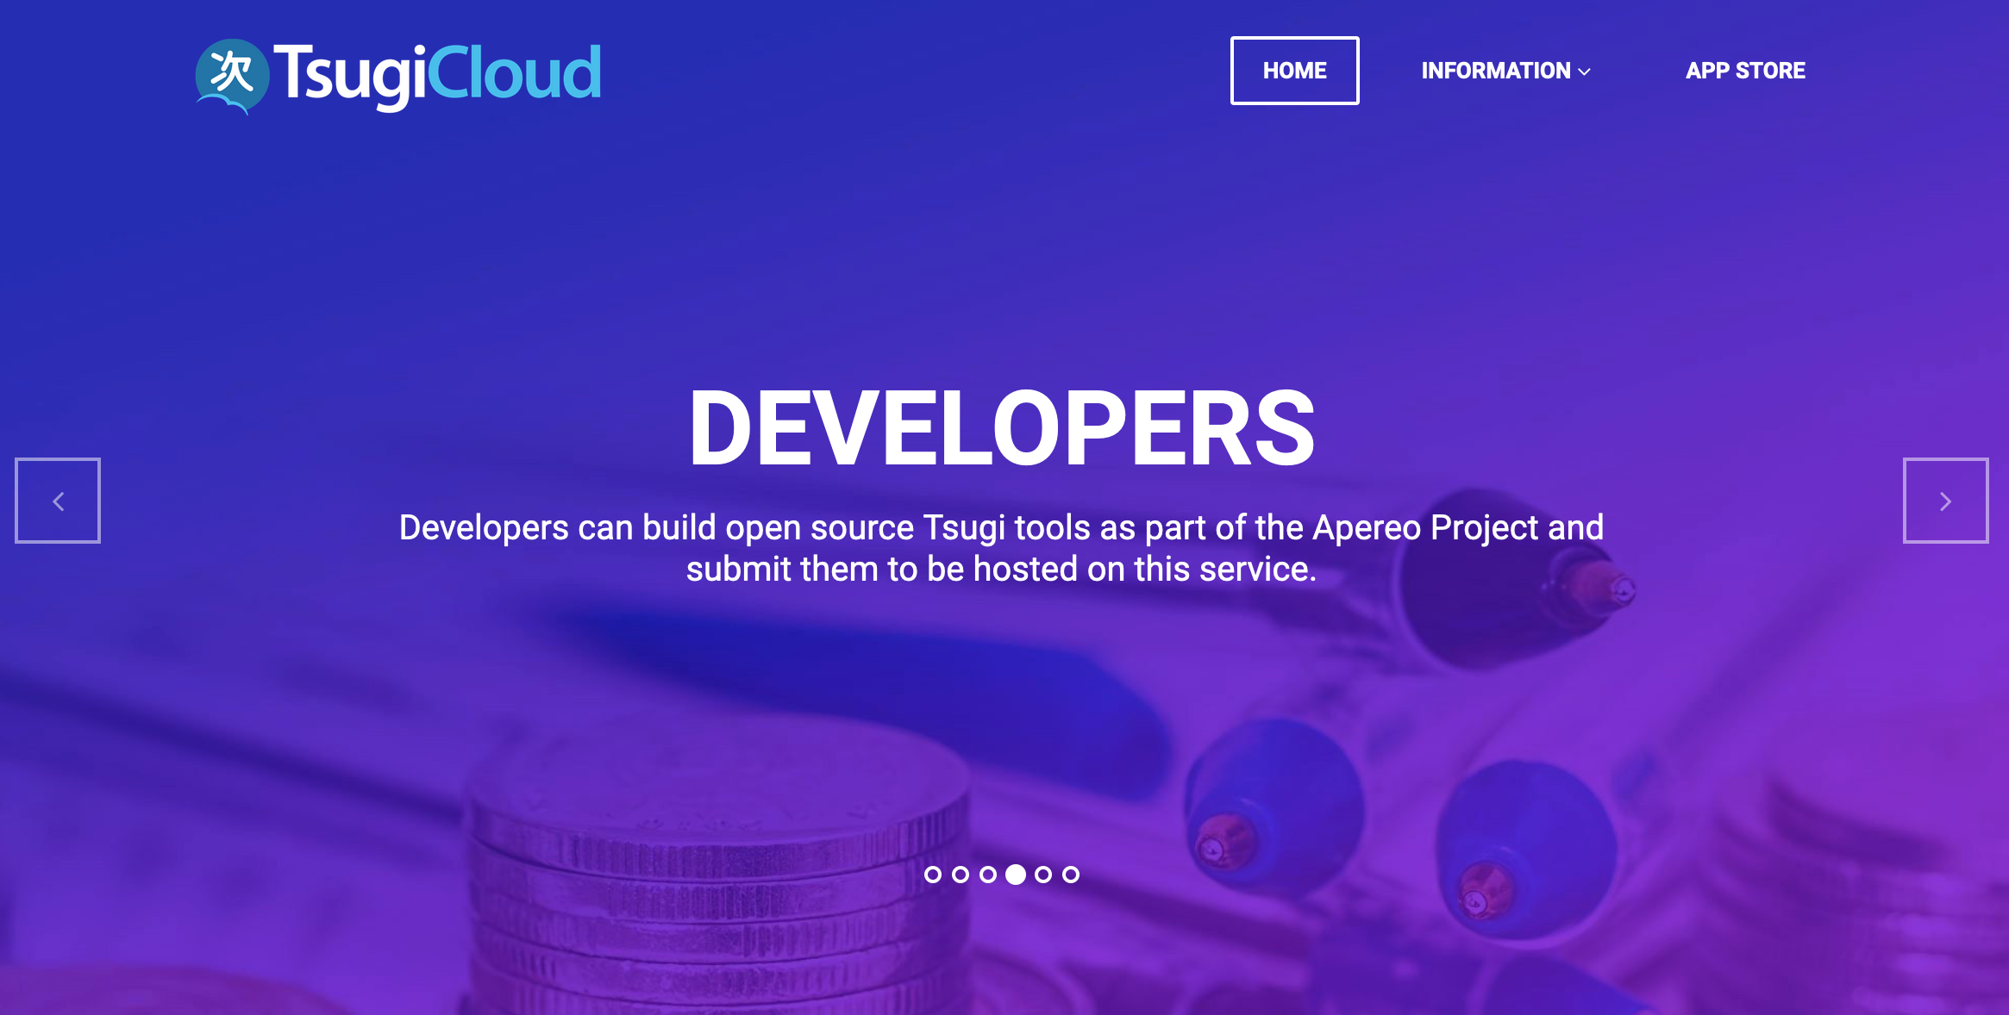

Slide 32
My OSS EdTech Goals @ 2020 • Present Tsugi at Moodle MOOTs • TsugiCloud shared hosting in Japan • Tsugi Developer Workshop for Sakai and Moodle Schools • Be an advocate for improving the privacy of student data

Slide 33
When you fix one problem….

Slide 34
Convenience
LTI
LTI
LTI
SASS
Based LMS
LTI
LTI
LTI
LTI
LTI
Self-hosted LMS
Data Stewardship / Privacy

Slide 35
Educause ELI, March 5-7, 2020
New Approaches to Protecting the Privacy of Student Learning Data
This session will talk about issues, concerns, and possible solutions around handing private student learning data to third parties. We propose a middle ground where software maintenance and upgrades can be out-sourced without also losing long-term control of your student data to software vendors. These ideas are aspirational in the hope that they can engender a better outsourcing model that we can encourage the learning software industry to adopt.

